Slide 1

DAB3014 Healthcare Analytics
Heart Failure Prediction

Slide 2
Timelines
Problem Statement
Objectives
Contribution
About Data
Knowing Data
Statistics Summary
Visualizing Risk Factors
Feature Engineering
Data Model(s) Building
Model’s Accuracy Summary
Model Deployment
Group 009 - Section 002
SMIT RANA - 792056
HARSH PATEL - 791820
RECHEL THOMAS REBELLO - 787548
DHRUV LIMBACHIYA - 784687
S

Slide 3
A heart attack occurs when blood flow to a portion of the heart is cut off partially or completely. Heart failure occurs when the heart is unable to effectively pump enough blood to all parts of the body.

Slide 4
Problem Statement *why we choose this project?
Every year, approximately 17 million people are killed by cardiovascular diseases, which primarily demonstrate as cardiac and heart failures.
It is a condition in which the heart is unable to pump enough blood to meet the body's requirements. Heart disease symptoms can include physical weakness, breathing problems, swelling feet, etc.
Healthcare industries generate massive amounts of data which contains hidden knowledge or patterns for decision making.
Healthcare Analytics can enable preventive cares like with EDA we can understand correlation between features. Moreover, A Machine Learning (ML) model can be very helpful in the early detection and care of people with cardiovascular disease or at high cardiovascular risk.
Therefore, there is a perfect fit between this project and this course.
S

Slide 5
Objectives *what were our objective before starting this project?
The project will be noted "successful" if it meets the following objectives:
Apply appropriate EDAs and Visuals of the risk factors for heart disease. So, Anyone can understand the correlation with target variable.
Achieving a prediction accuracy of between 80 to 90 for model employed in the project to win the public's trust and confidence. (by testing different machine learning model and choose best among them)
By entering 11 attributes from our dataset, an ML Model will be deployed to a webpage to predict the death event caused by heart failure.
S

Slide 6
Contribution *assigning different project phases.
Below is a breakdown of how the our teamwork will be distributed according to project phases. The team intends to work discretely throughout the whole project.
 | Data Collection | Preprocessing & Cleaning | EDAs | Visualization & Dashboards | Apply ML Models | Deployment
Smit Hareshkumar Rana [792056] | ✓ | ✓ |  | ✓ | ✓ | ✓
Harsh Girishkumar Patel [791820] | ✓ |  | ✓ |  | ✓
Rechel Thomas Rebello [787548] | ✓ |  | ✓ | ✓
Dhruvkumar Limbachiya [784687] | ✓ | ✓ |  | ✓
S

Slide 7
About our data UCI Machine Learning Repository : https://archive.ics.uci.edu/ml/datasets/Heart+failure+clinical+records
The dataset holds 299 records with 13 attributes such as,
age: The person's age
anaemia: Red blood cell or haemoglobin decrease (boolean)
creatinine phosphokinase: CPK enzyme concentration in the blood (mcg/L)
diabetes: If the patient suffers from diabetes (boolean)
ejection_fraction: % of blood leaving the heart at each contraction (%)
high_blood_pressure: If the patient has high blood pressure (boolean)
platelets: Blood platelets (kiloplatelets/mL)
serum_creatinine: Serum creatinine level in the blood (mg/dL).
serum_sodium: Serum sodium concentration in the blood (mEq/L)
sex: by a woman or a man (binary)
smoking: Whether or not the patient smokes (boolean)
time: Period of follow-up (days)
alive: if the patient died during the follow-up period (boolean)
D

Slide 8
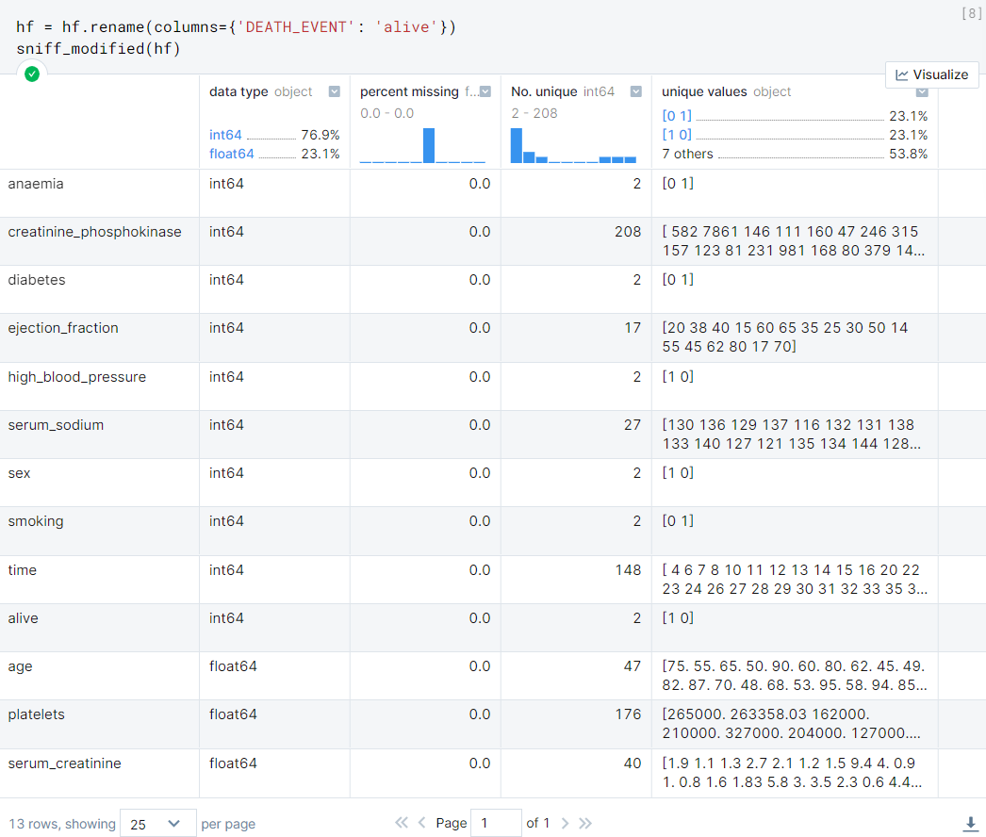
Knowing Data
All attributes have 299 non-null values, so there are no missing values.
The datatype is also 'float64' or 'int64,' which works well when fed into an models.
D

Slide 9
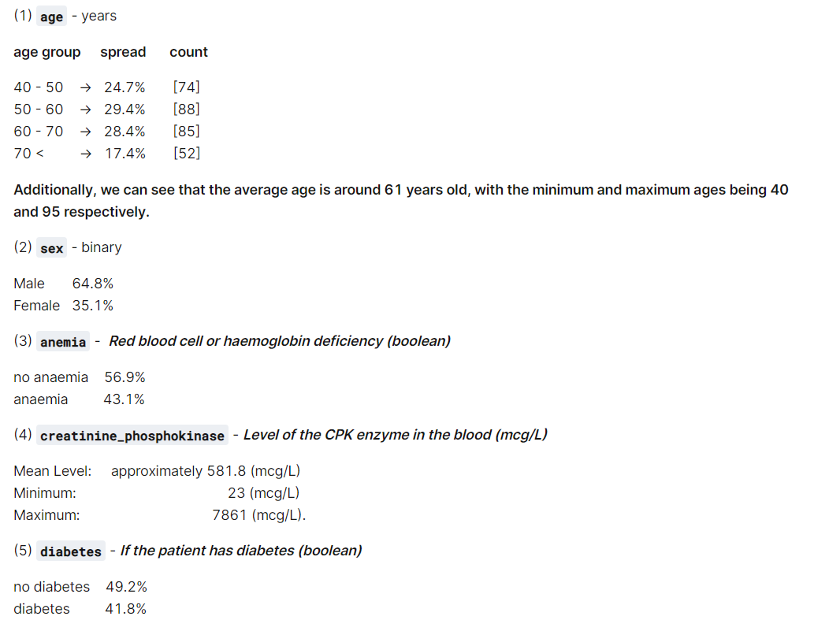
Statistics Summary
D

Slide 10
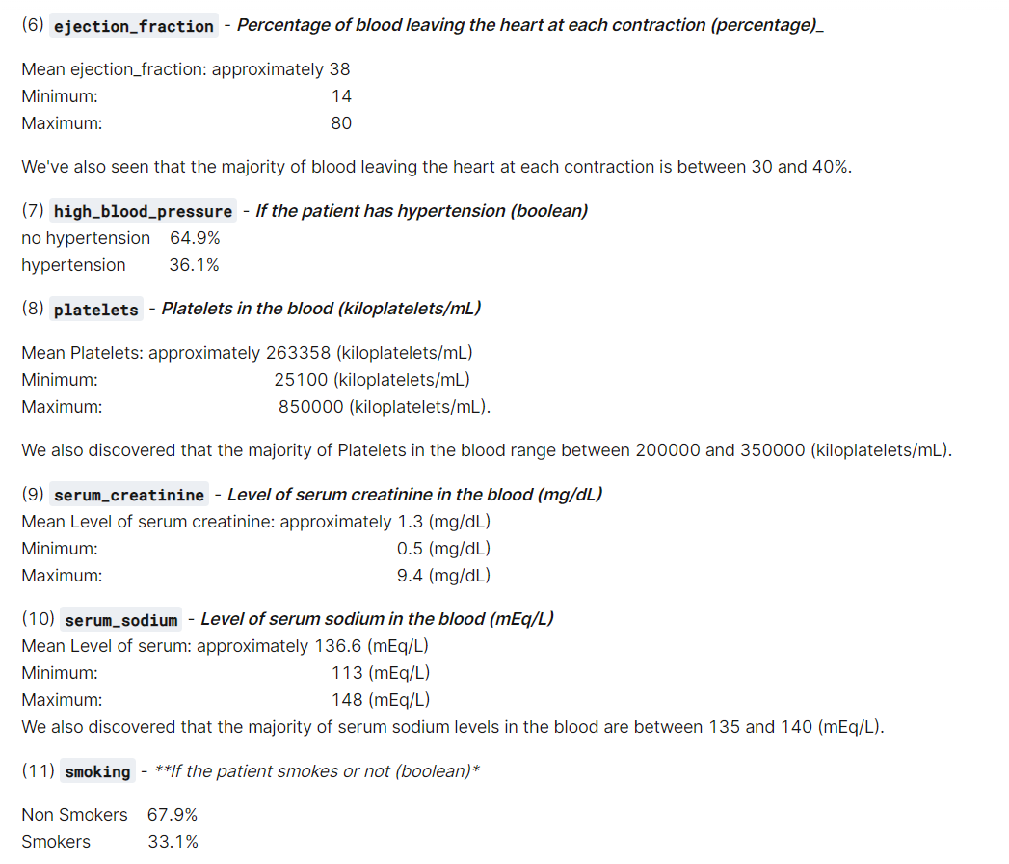
Statistics Summary
D

Slide 11
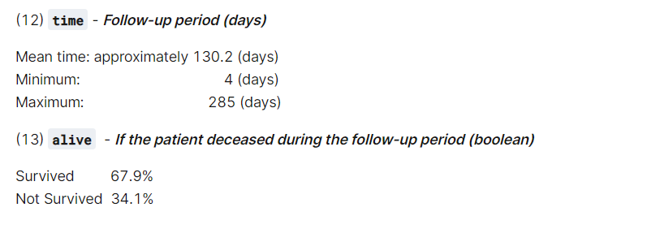
Statistics Summary
D

Slide 12
Visualizing Risk Factors

Slide 13
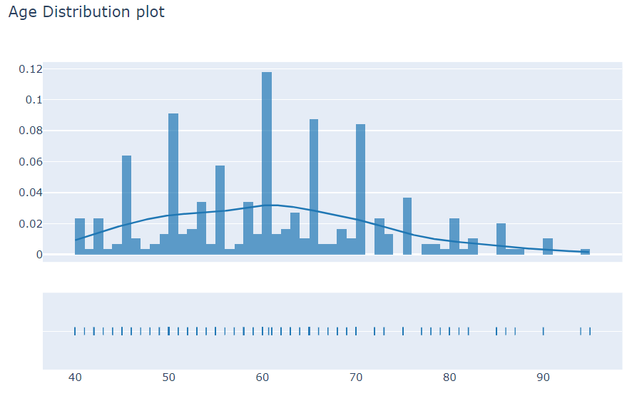
Age Distribution
Age groups under 40 and over 80 are hardly represented, while those between 40 and 80 are widely dispersed.
R

Slide 14
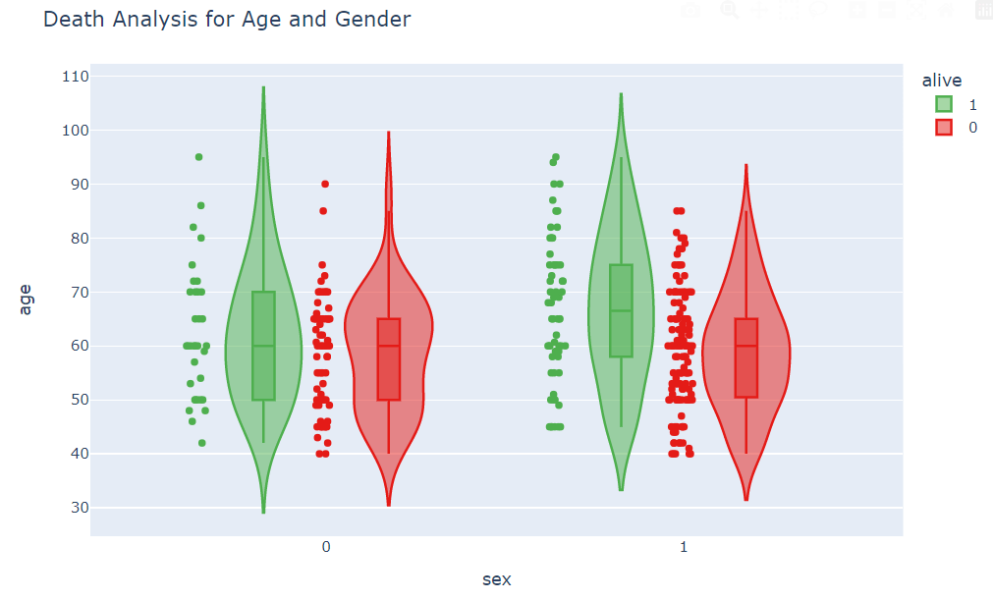
Death Analysis by age and gender
Ages between 40 and 70 have a high rate of surviving. Males and females, 50 to 60 and 60 to 70 years old, respectively, both survived heart disease.
R

Slide 15
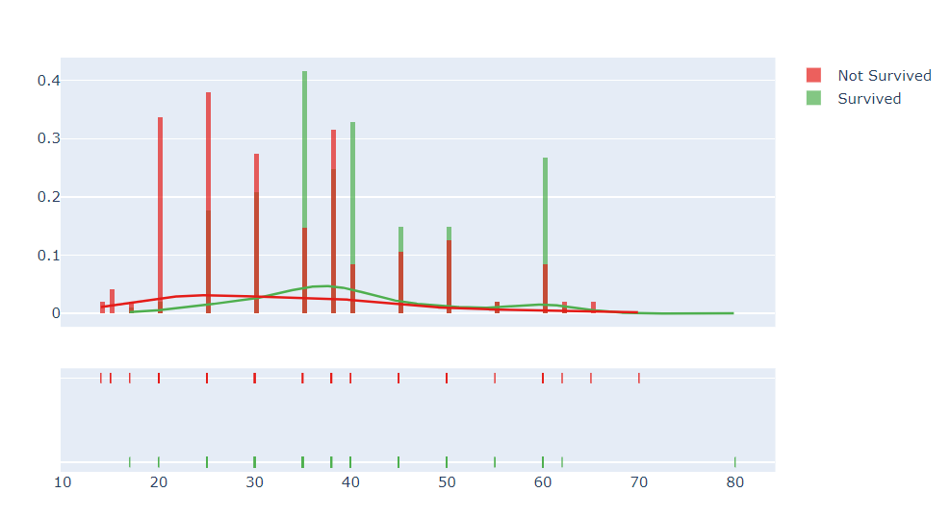
Death Analysis by Ejaction Fraction
ejaction fraction values between 20 and 40 result in a record number of deaths.
R

Slide 16
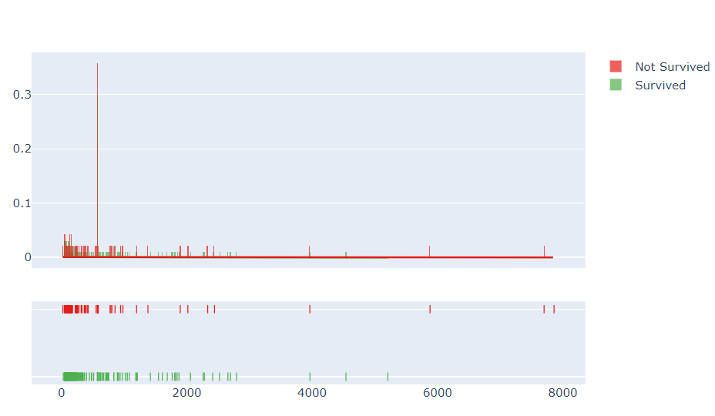
Death Analysis by creatinine phosphokinase
For creatinine phosphokinase values ranging from 0 to 500, death cases are
R

Slide 17
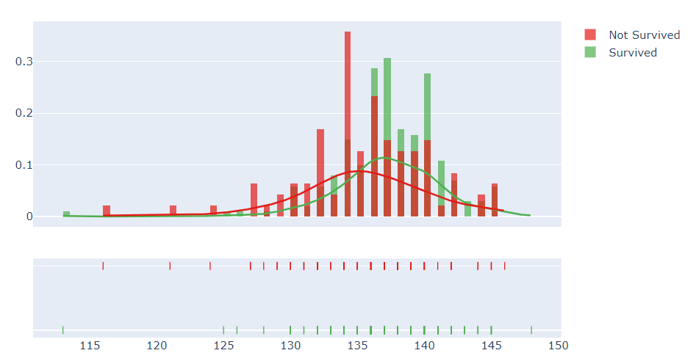
Death Analysis by serum sodium
serum_sodium values 127 - 145 indicate towards a death due to heart failure.
R

Slide 18
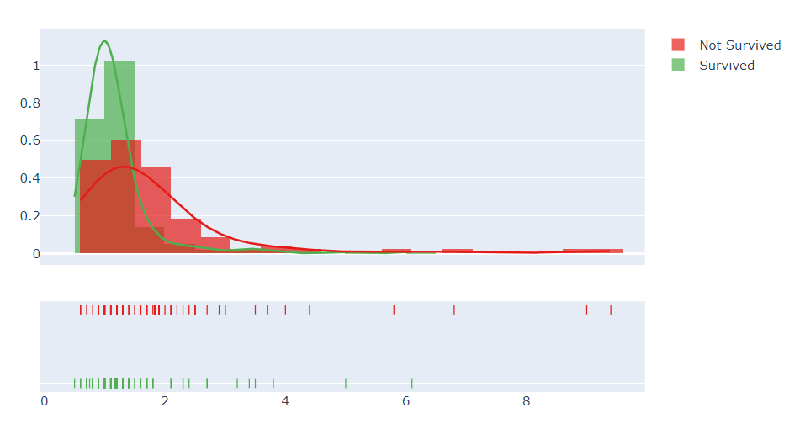
Death Analysis by creatinine phosphokinase
serum_creatinine values from 0.6 to 3.0 have higher probability to lead to death
R

Slide 19
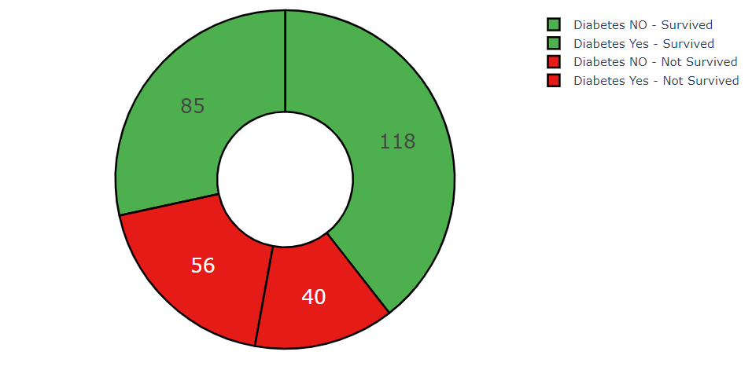
Analysis on Diabetes
From the pie charts, we may deduce that in our dataset,
non-diabetic
118 lived, while 56 did not,
diabetes
and 85 survived, while 40 did not.
H

Slide 20
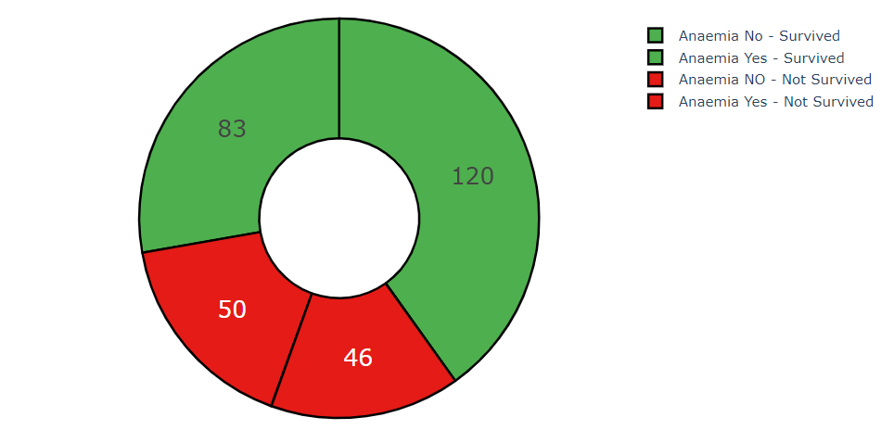
Analysis on Anemia
Based on the pie charts above, we can conclude that in our dataset
non-anemic
120 survived and 50 did not
anaemic
83 of the survived, while 46 did not.
H

Slide 21
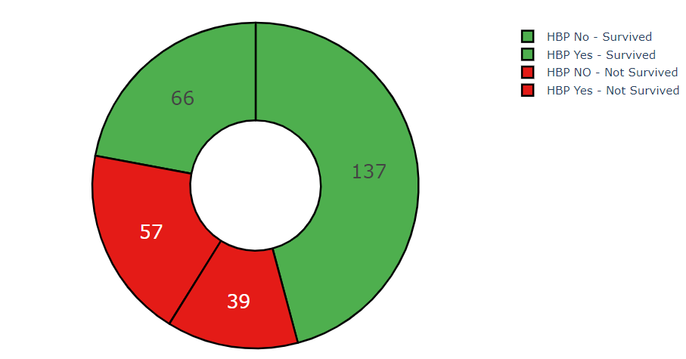
Analysis on High Blood Pressure
Based on the pie charts above, we can conclude that in our dataset,
No HBP
137 survived, while 57 do not
HBP
66 survived, while 39 did not.
H

Slide 22
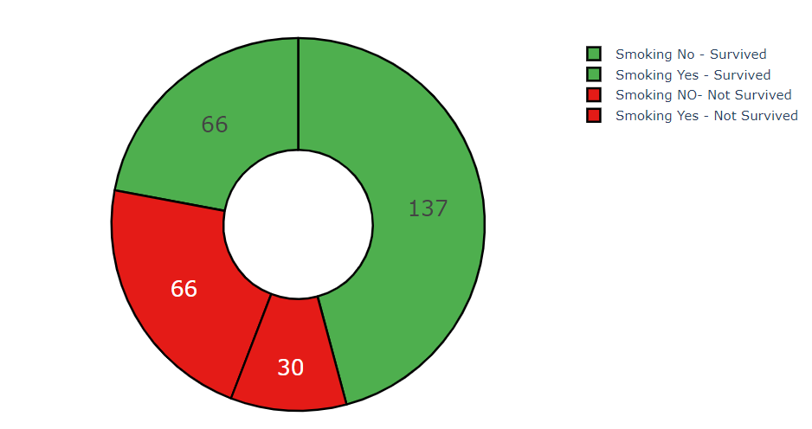
Analysis on Smoking
Based on the pie charts above, we can conclude that in our dataset,
From nonsmokers.
137 survived, while 66 died.
And 66 survived and 30 not are smokers
H

Slide 23
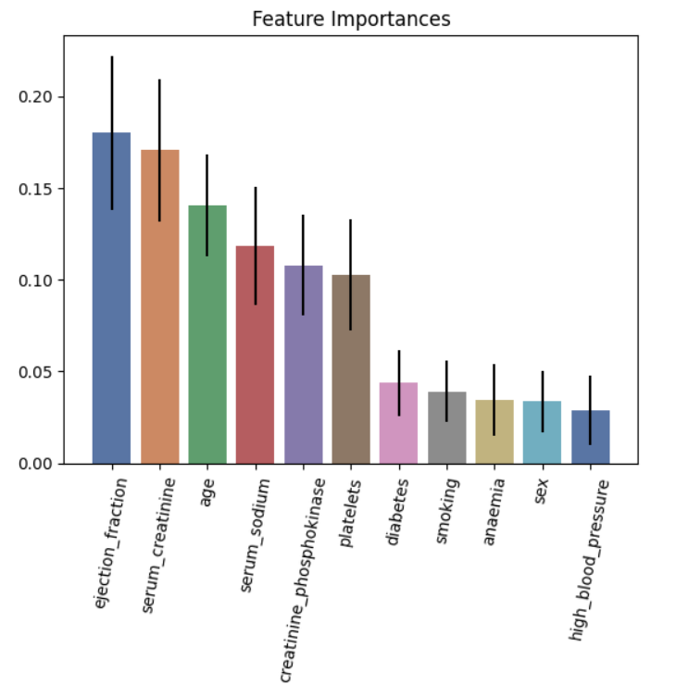
Feature Engineering
We will not use the feature time because it has no precise meaning (like death/alive can’t predict by follow-up days), even if the correlation map shows that the time feature and the target are correlated
H

Slide 24
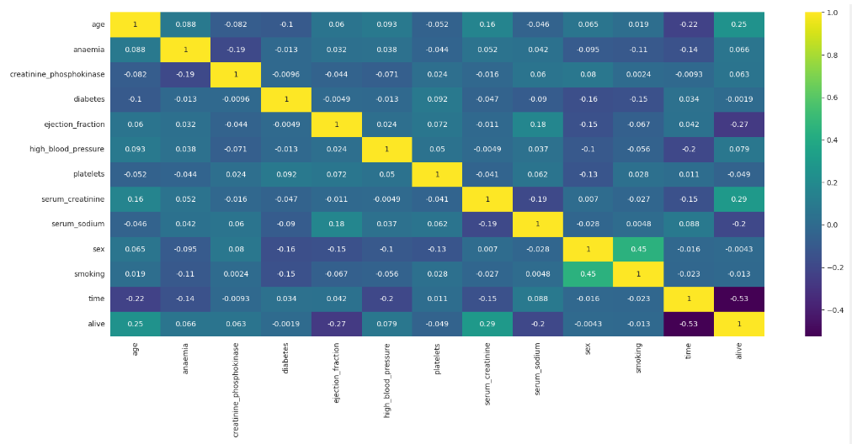
Correlation between features
H

Slide 25
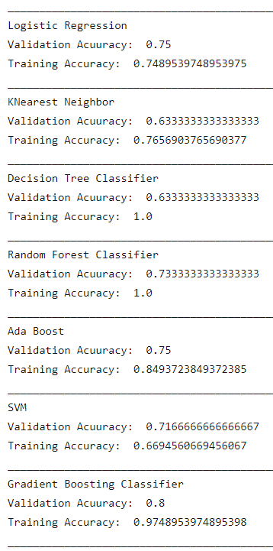
Data Model(s) Building
H

Slide 26
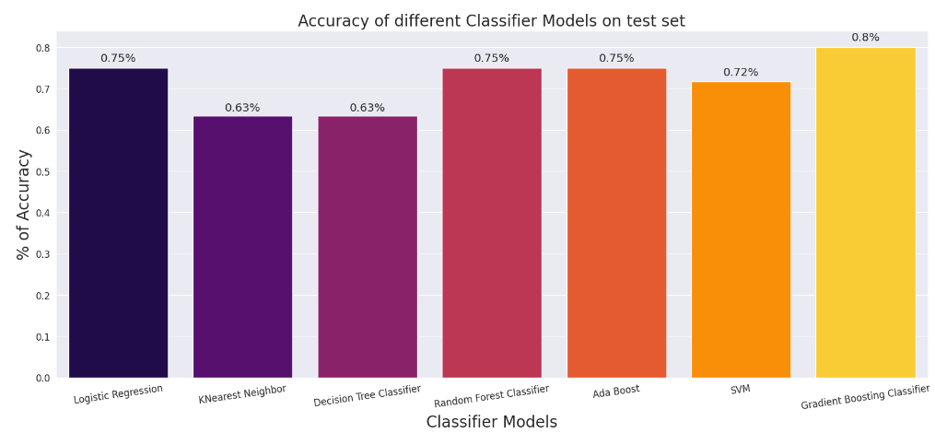
Model’s Accuracy Summary
H

Slide 27
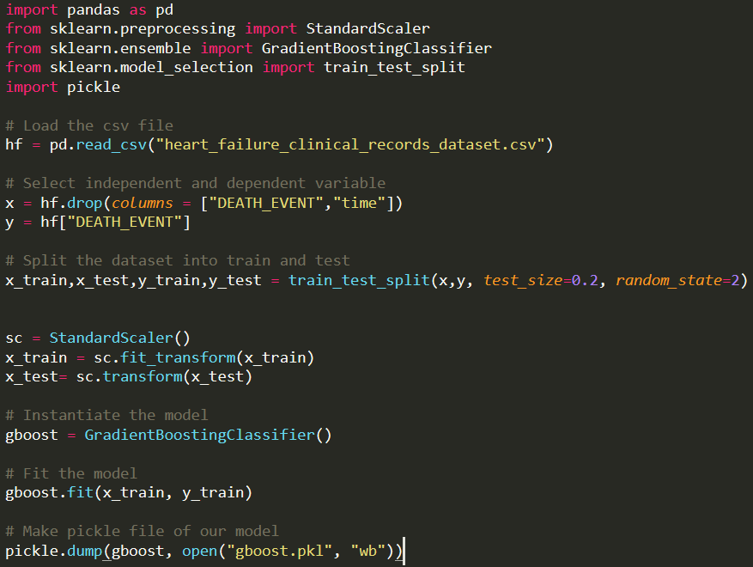
Model Deployment
model.py
Saving the Gradient Boosting model into gboost.pkl
S

Slide 28
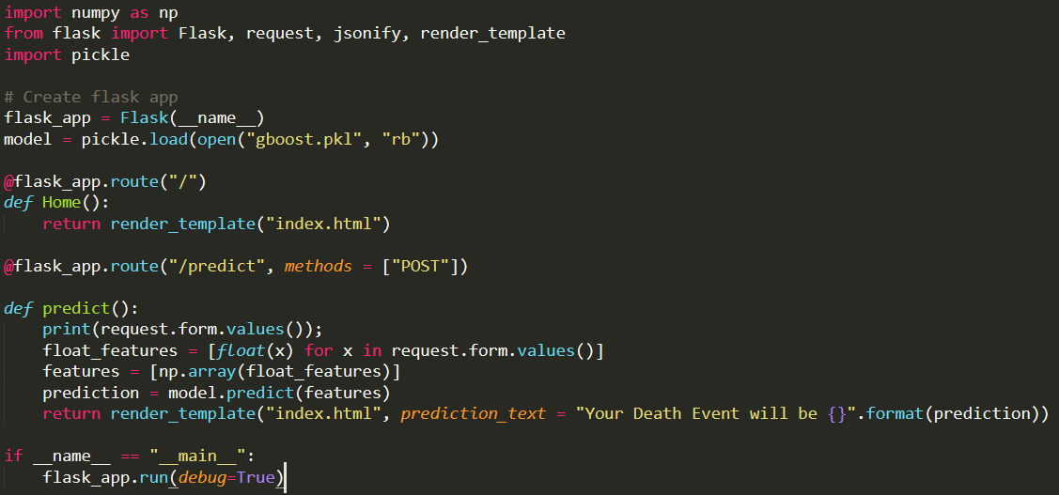
Model Deployment
app.py
getting input through html webpage
Loading the model from gboost.pkl
Predict output from collected input by saved model gboost.pkl
Displaying what model predicted
S

Slide 29
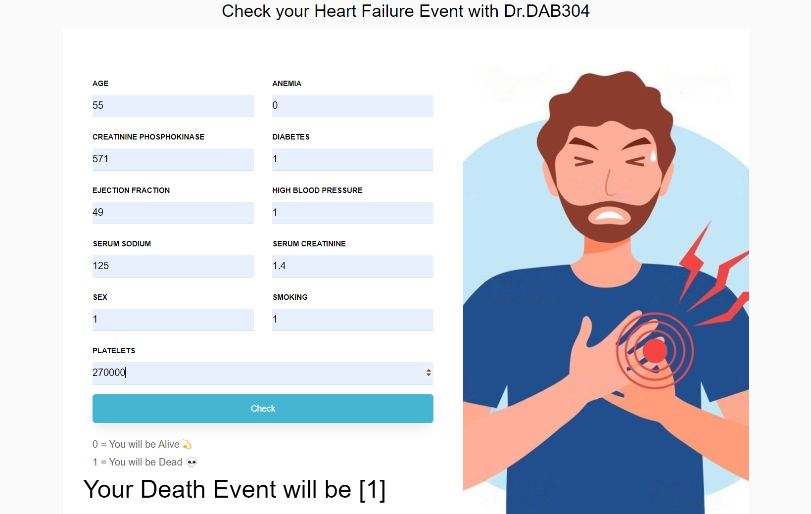
Model Deployment
S

Slide 30
Conclusion
Order / Values of features for positive cases of heart failure (DEATH_EVENT) :
Categorical Features (Order) :
high_blood_pressure : High Blood Pressure > No High Blood Pressure
sex : Male > Female
smoking : Smoking > No Smoking
Numerical Features (Range) :
age : 50 - 70
creatinine_phosphokinase (cpk): 0 - 500
ejaction_fraction : 20 - 40
platelets : 200,000 - 300,000
serum_creatinine : 1 - 2
serum_sodium : 130 - 140
According to our data, these order / range of values leads to heart failures.

Slide 31
Thank You

